Slide 1
File I/O

Slide 2
Java being one of the most popular programming languages provides extensive support to various functionalities like database, sockets, etc. One such functionality is File Handling in Java. File Handling is necessary to perform various tasks on a file, such as read, write, etc.
Topics to be covered
What is File Handling in Java?
What is a Stream?
Java File Methods
File Operations in Java

Slide 3
What is File Handling in Java?
File handling in Java implies reading from and writing data to a file. The File class from the java.io package, allows us to work with different formats of files. In order to use the File class, you need to create an object of the class and specify the filename or directory name.
For example:
// Import the File class
import java.io.File
// Specify the filename
File obj = new File("filename.txt");

Slide 4
Java uses the concept of a stream to make I/O operations on a file. So let’s now understand what is a Stream in Java.
What is a Stream?
In Java, Stream is a sequence of data which can be of two types.
1. Byte Stream
This mainly incorporates with byte data. When an input is provided and executed with byte data, then it is called the file handling process with a byte stream.
2. Character Stream
Character Stream is a stream which incorporates with characters. Processing of input data with character is called the file handling process with a character stream.
Next, we look at various methods that are useful for operations on the files like creating, reading and writing.

Slide 5
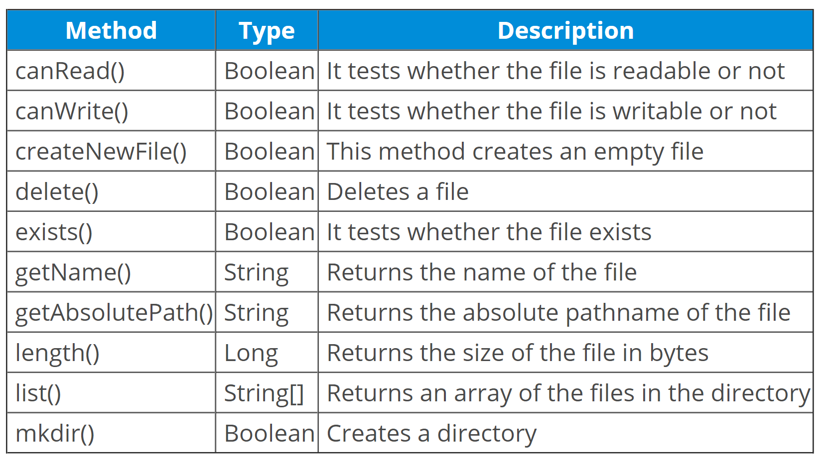
Java File Methods
Below table depicts the various methods that are used for performing operations on Java files.

Slide 6
File Operations in Java
Basically, you can perform four operations on a file. They are as follows:
Create a File
Get File Information
Write To a File
Read from a File
Let’s see an example of how to create a file in Java.
Program
In the above code, a file named NewFilef1 gets created in the specified location. If there is an error, then it gets handled in the catch block. Let’s check the output on executing the above code:
Output:
File created: NewFilef1.txt

Slide 7
In the above code, a file named NewFilef1 gets created in the specified location. If there is an error, then it gets handled in the catch block. Let’s check the output on executing the above code:
Output:
File created: NewFilef1.txt
Having understood this, let’s see how to get File information.
Get File information
Let’s see how to get file information using various methods with the help of below example code

Slide 8
Write to a File
In the following example, I have used the FileWriter class together with its write() method to write some text into the file. Let’s understand this with the help of a code.
Output:
Successfully wrote to the file
When you run the file, the above text, “Java is the prominent programming language of the millennium!” will be entered in the file that you have created. You can cross check it by opening the file in the specified location.
Now let’s move further and understand the last operation on the file, i.e. Read a file

Slide 9
4. Read from a File
In the following example, I have used the Scanner class to read the contents of the text file.
Example
Java is the prominent programming language of the millennium!

